Slide 1
Evaluation Budget Made Simple
WELCOME
Janet Ray, LMSW
Maria Schmieder, LMSW
Abigail Bartlett, BSW
May 9, 2019

Slide 2
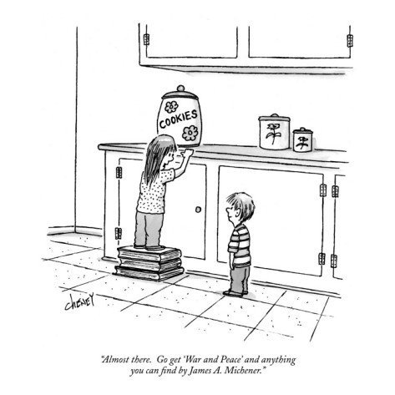
Almost Like Cookies

Slide 3
Learning Objectives
Know the key vocabulary and elements of an evaluation project
Know what is a reasonable evaluation budget
3. How to use an automatic Excel template to create an evaluation budget

Slide 4
How Do You Respond When You Hear Evaluation Budget or RFP?
Notes:
Instruction Note: Use a Real Time Evaluation such as colored post it notes for animal

Slide 5
Mission Accomplished!

Slide 6
WANT MORE INFORMATION
JANET RAY
JanetRay@Mission-Lift.com
313.320.4850

